Slide 1


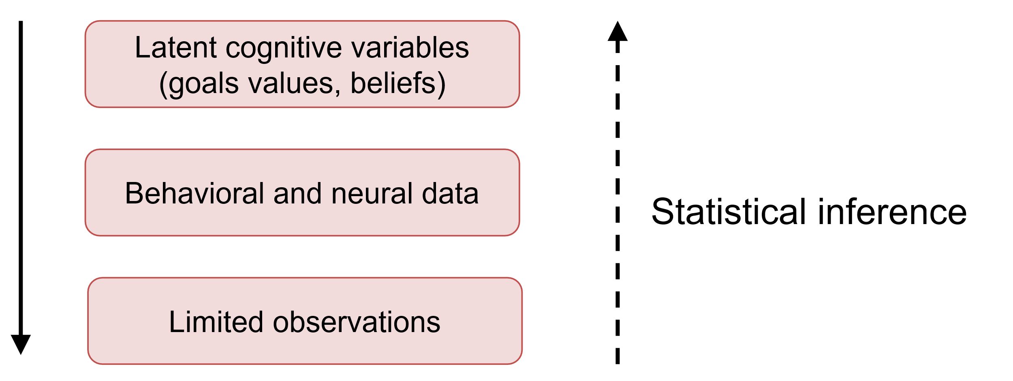
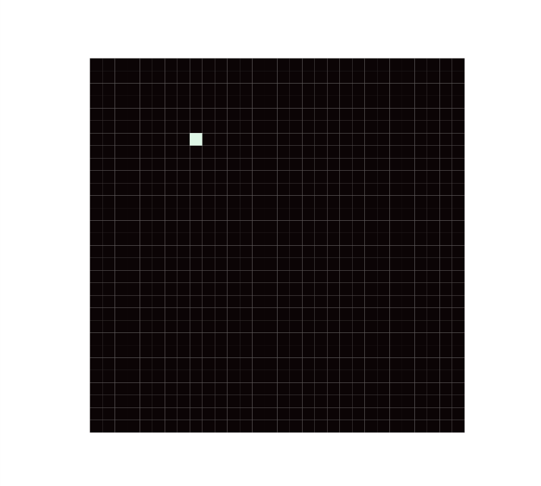
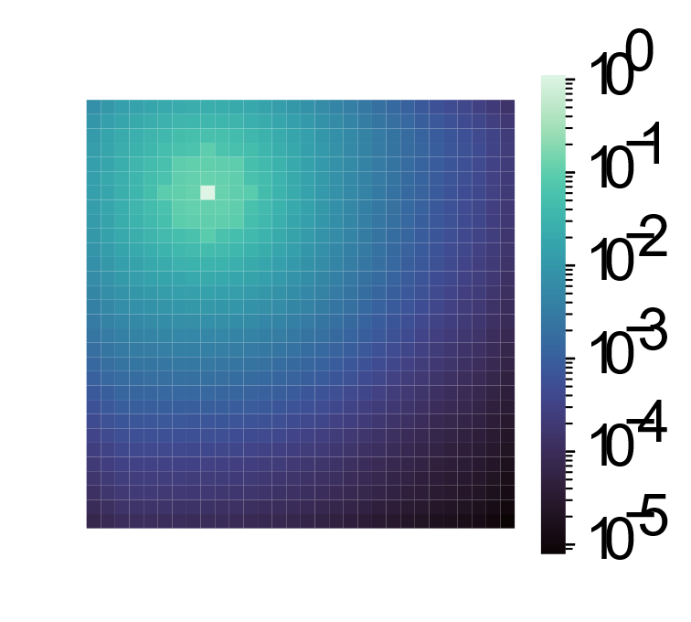
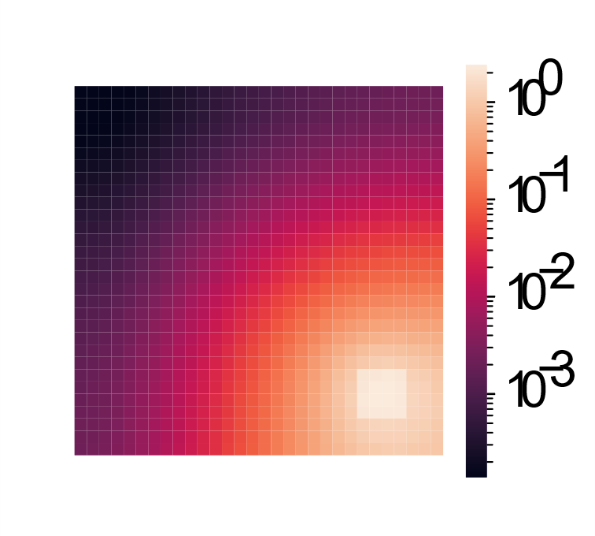
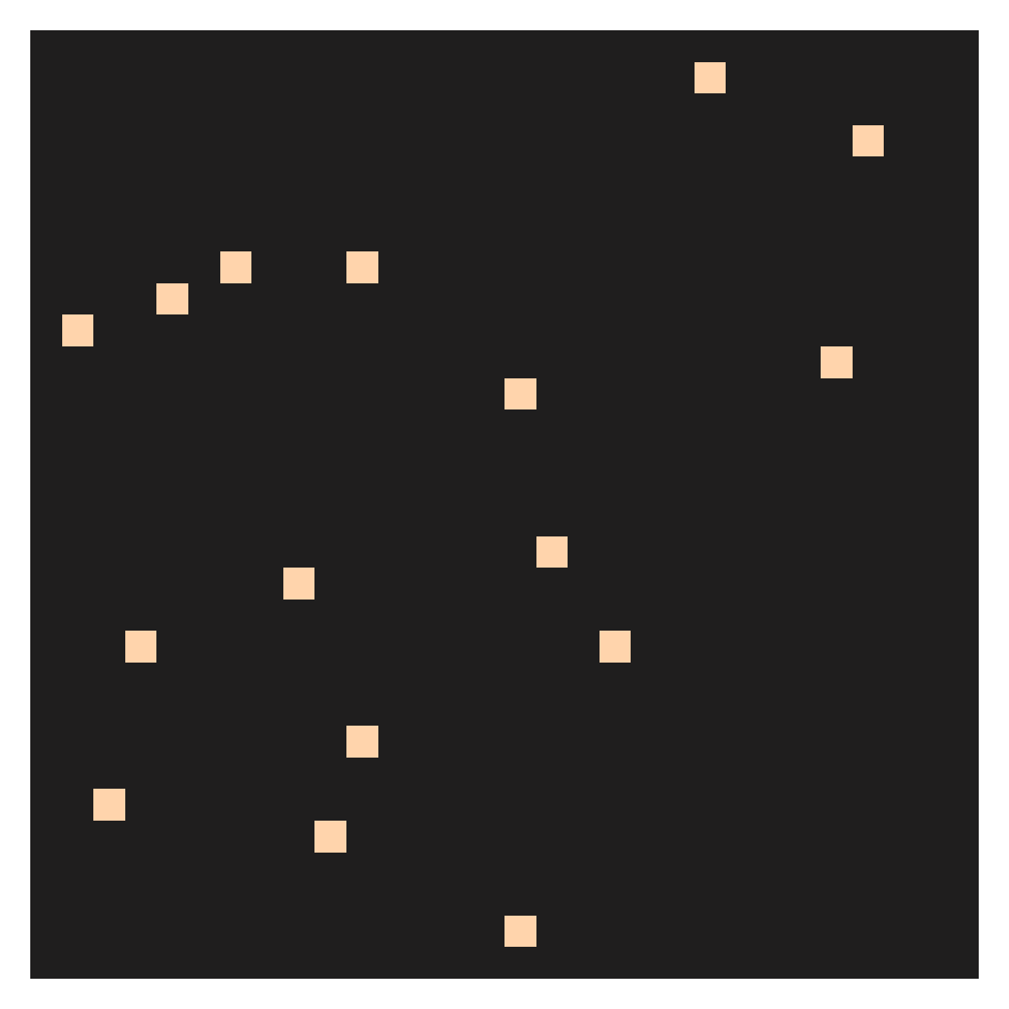
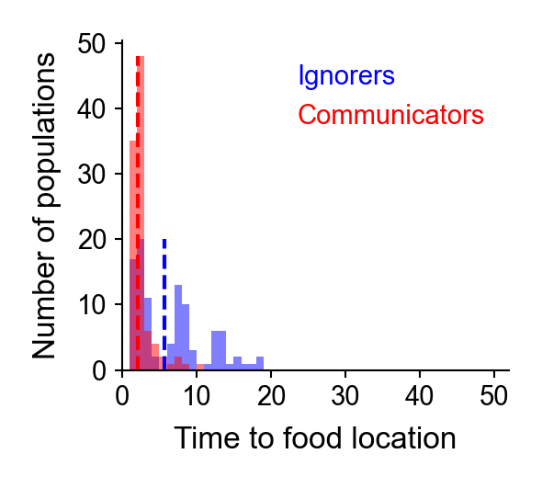
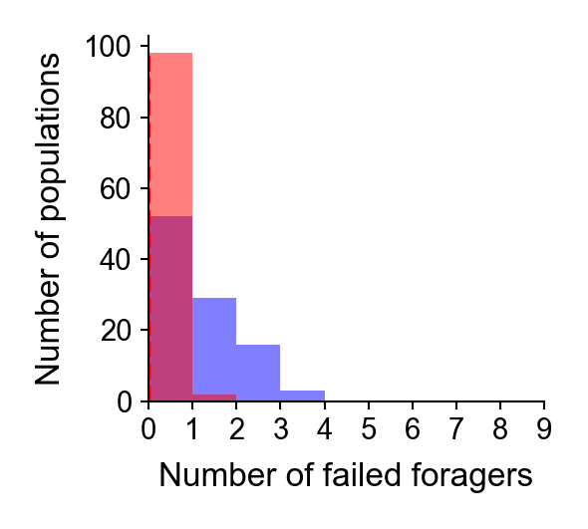
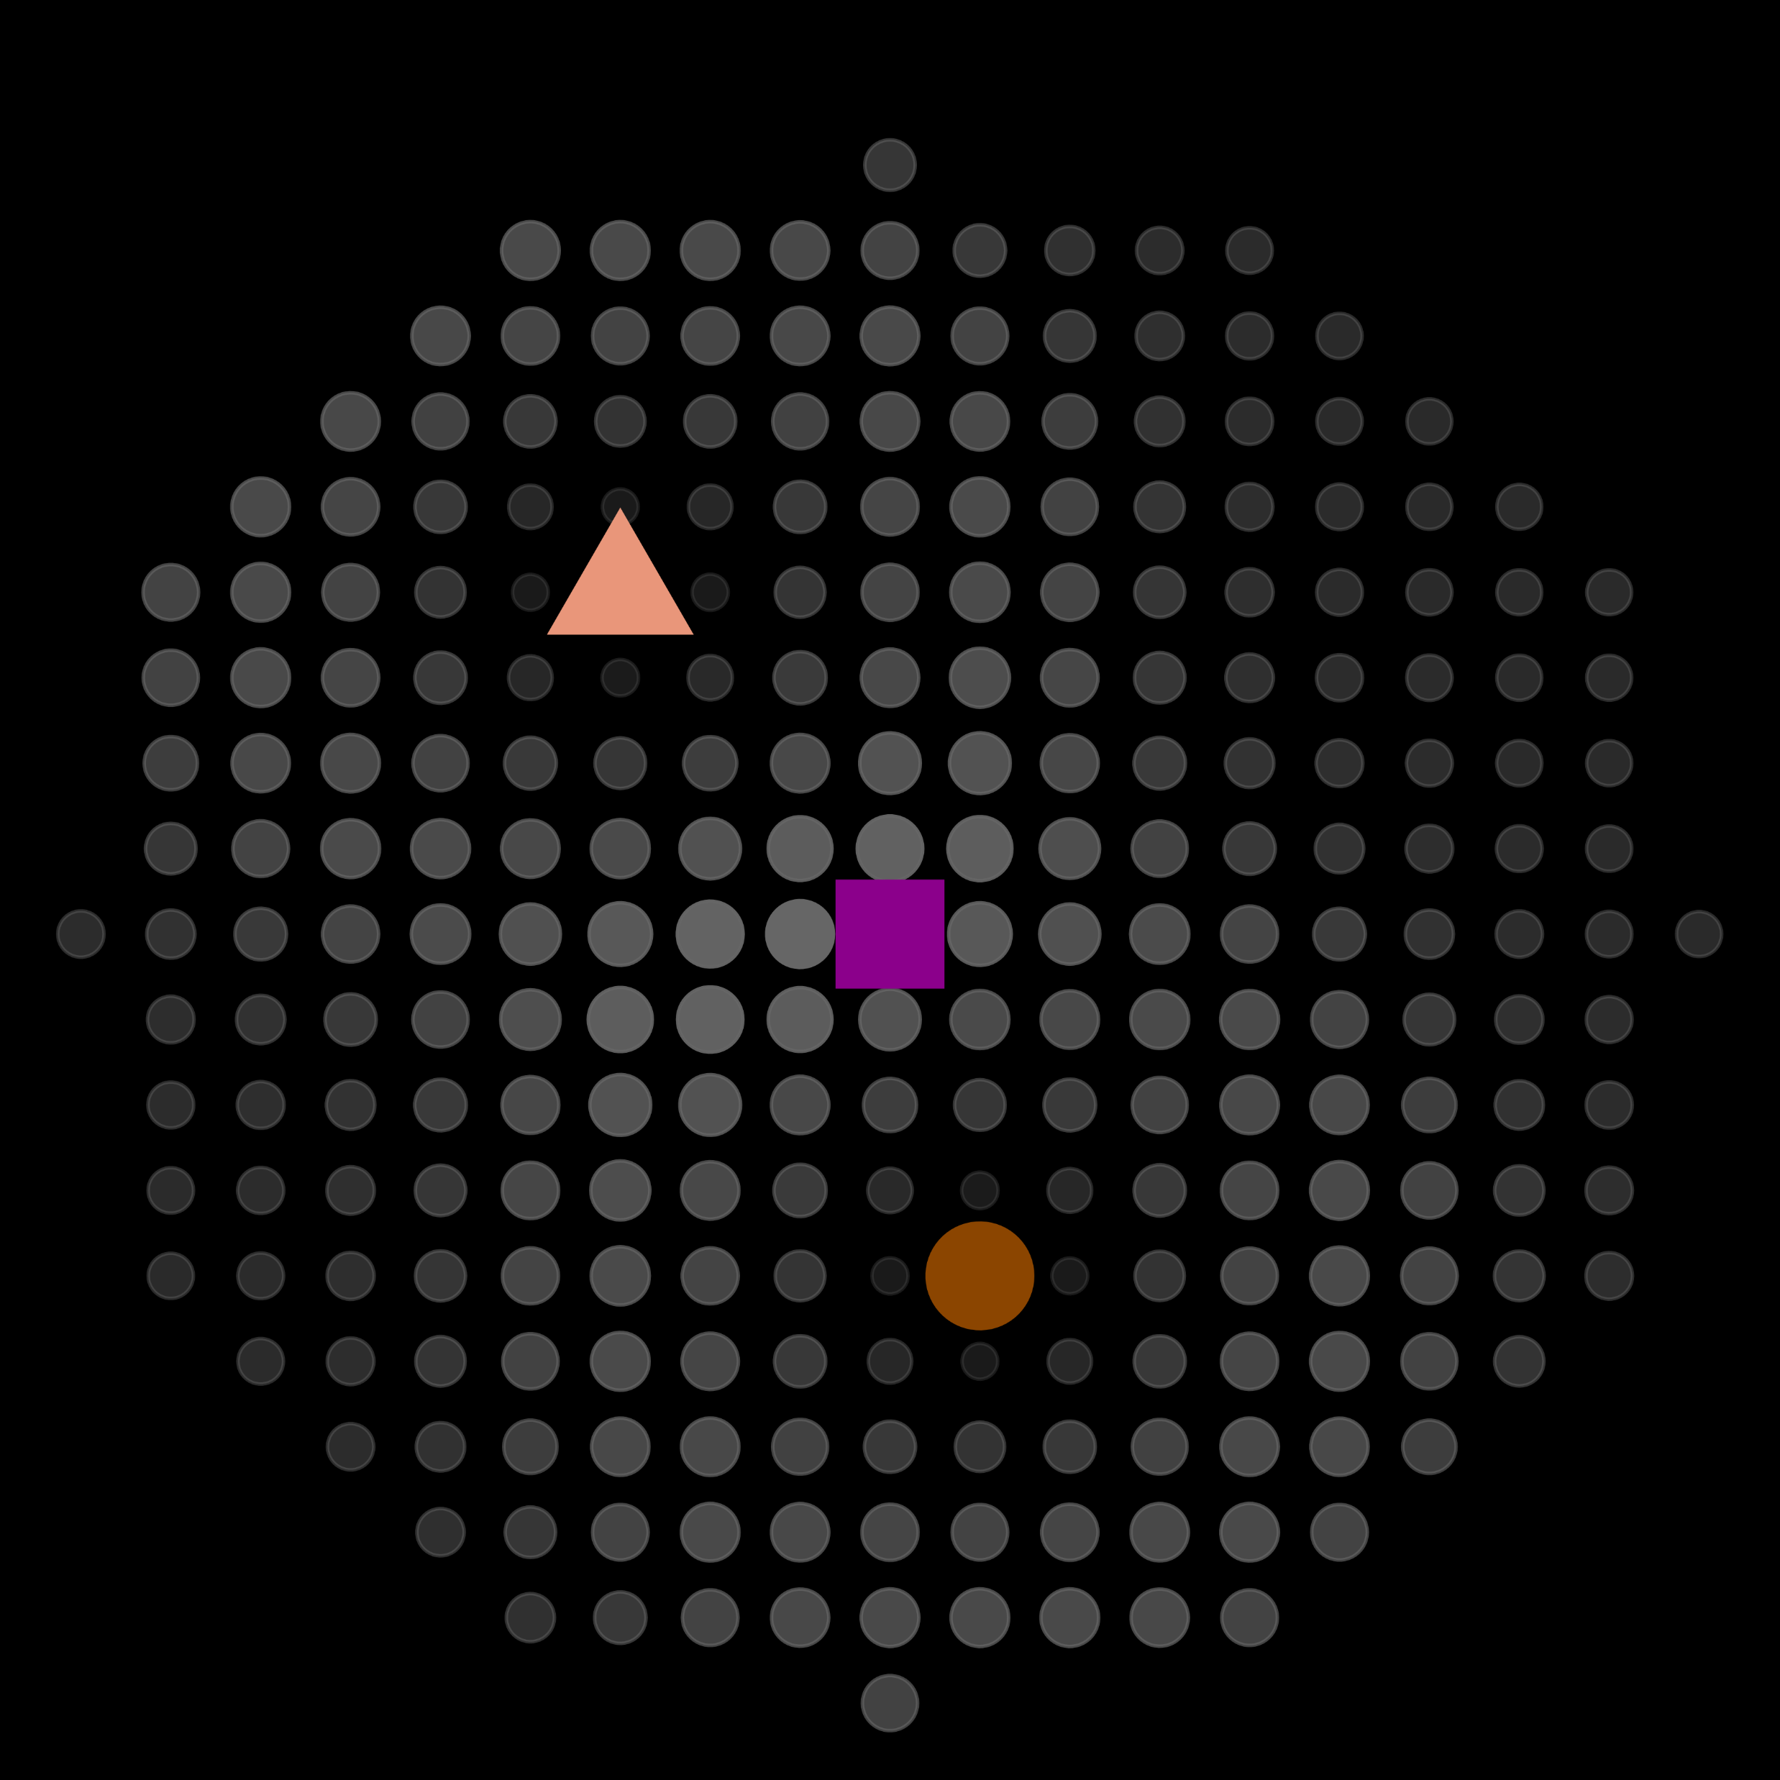

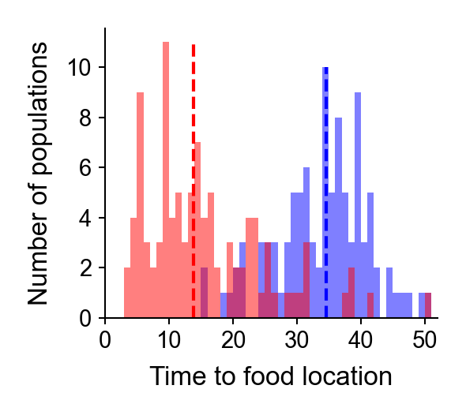
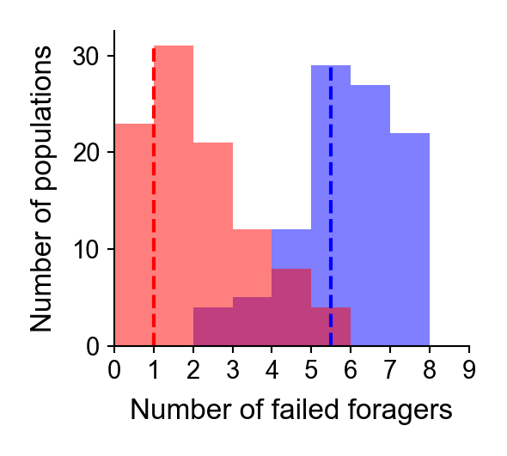

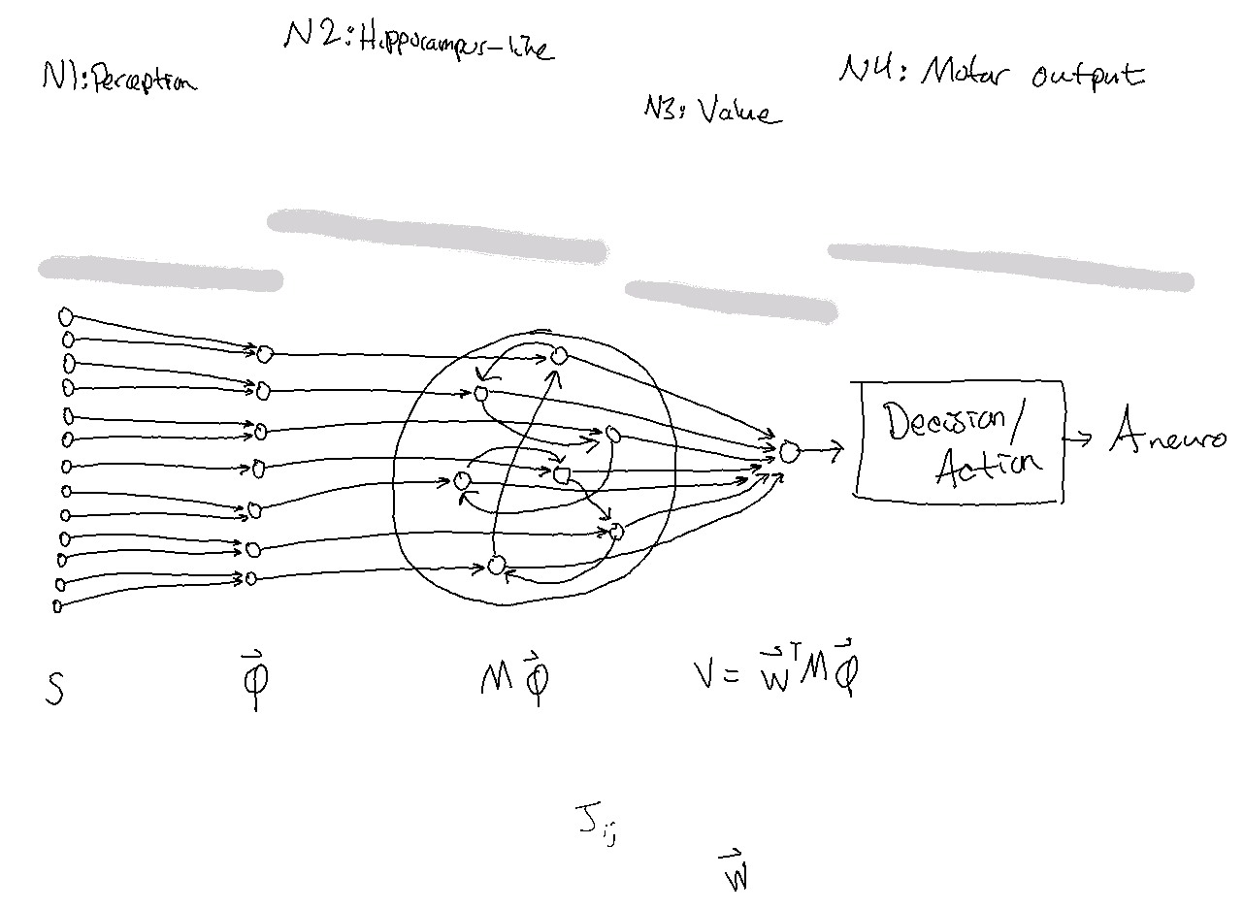
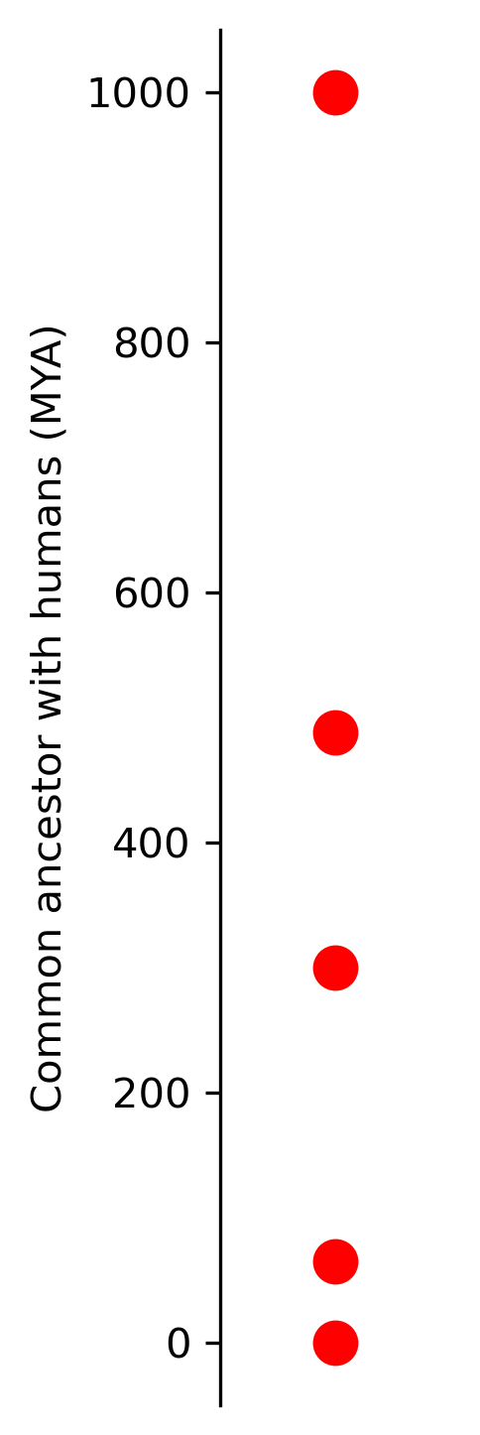
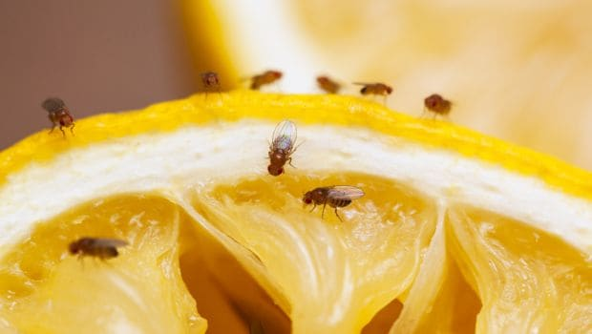
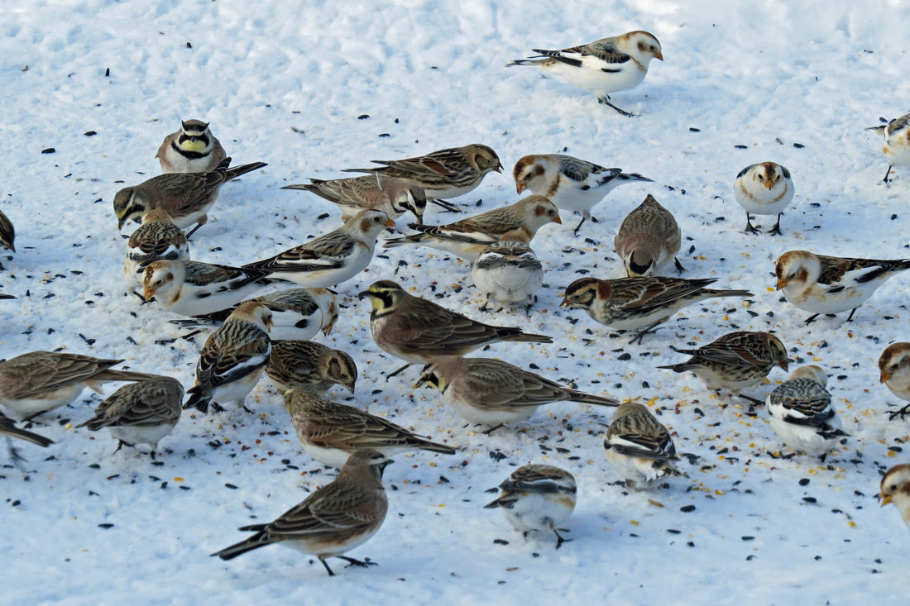
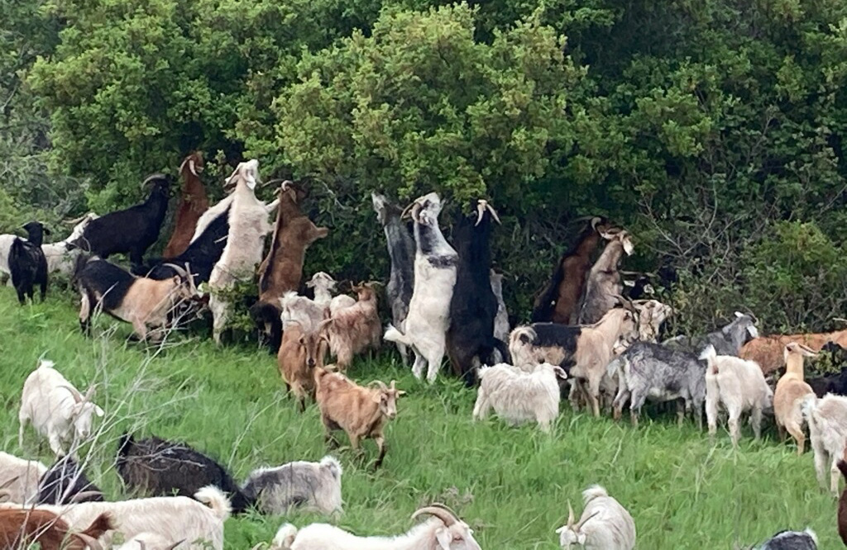
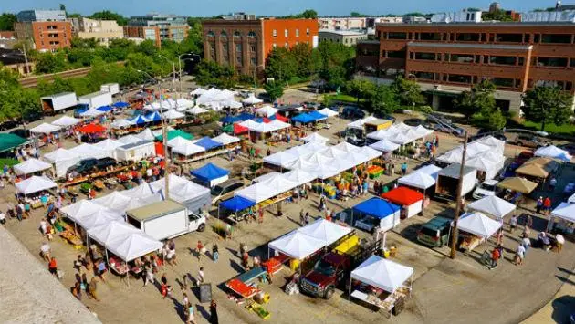
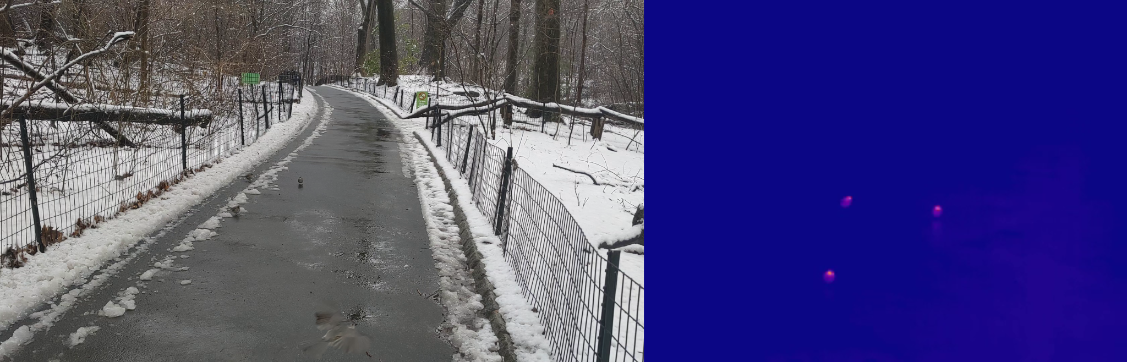
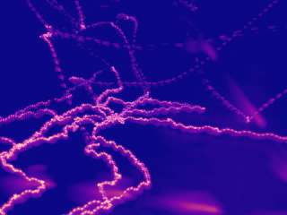
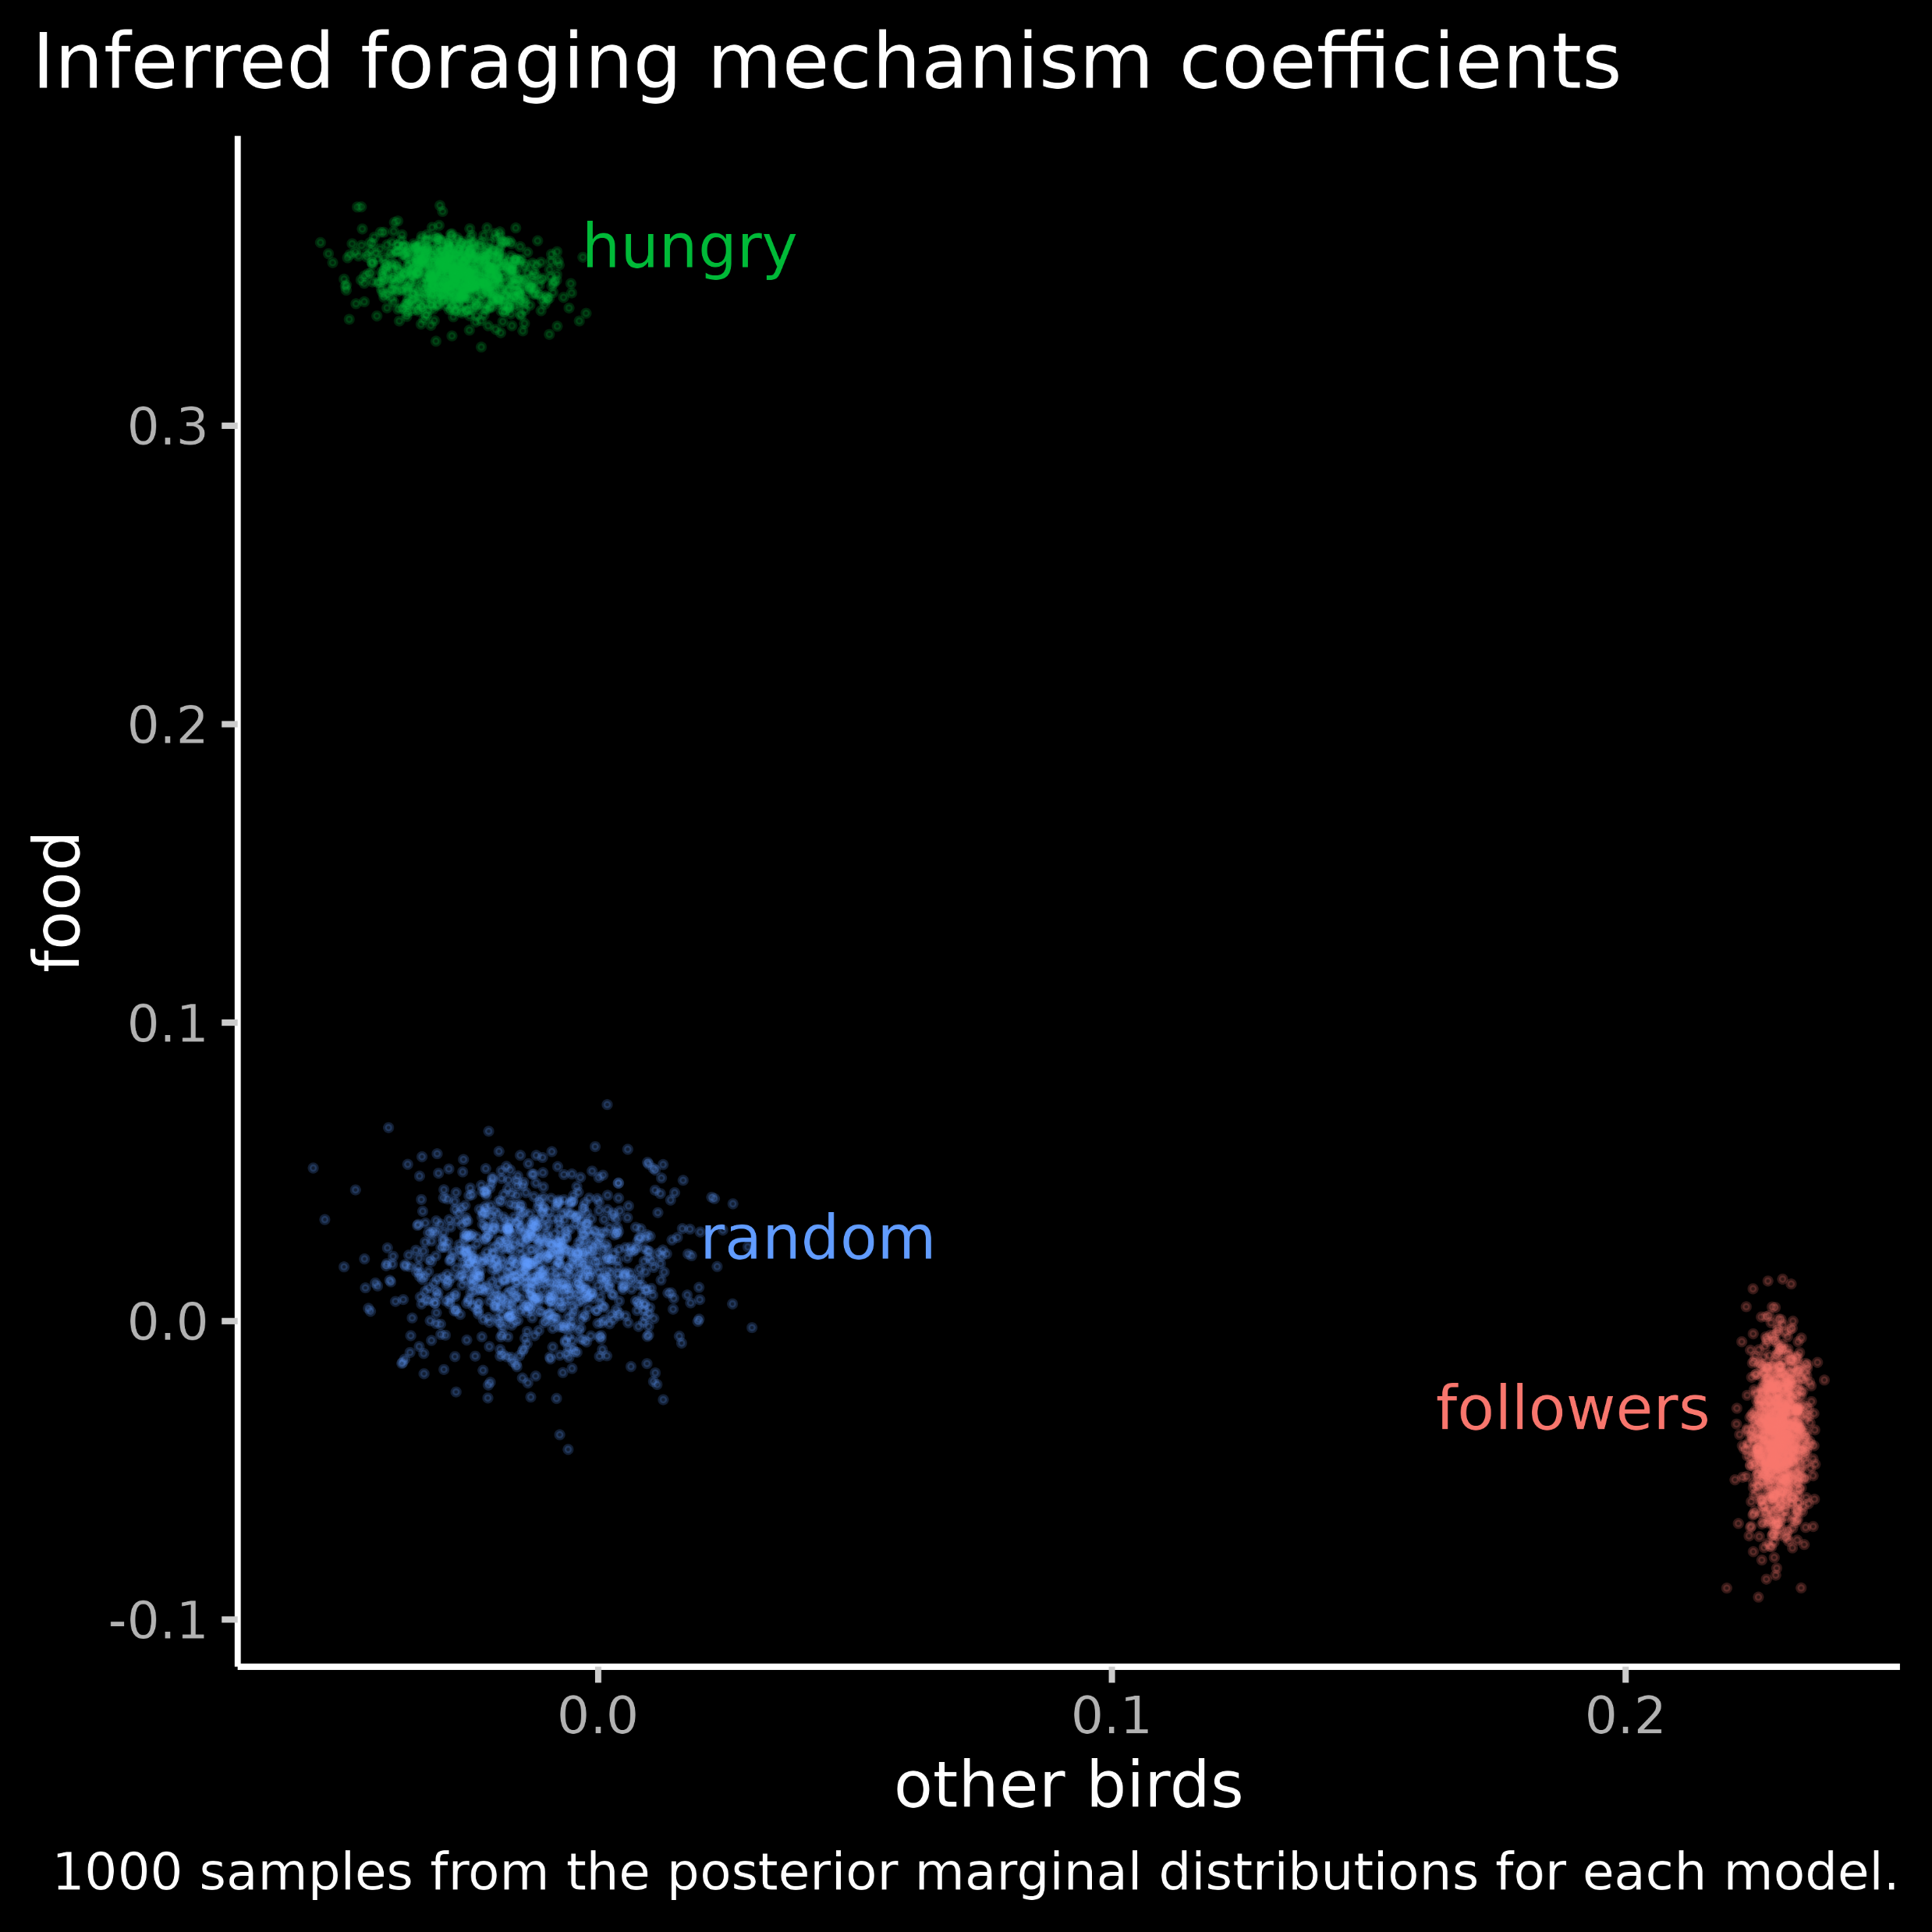
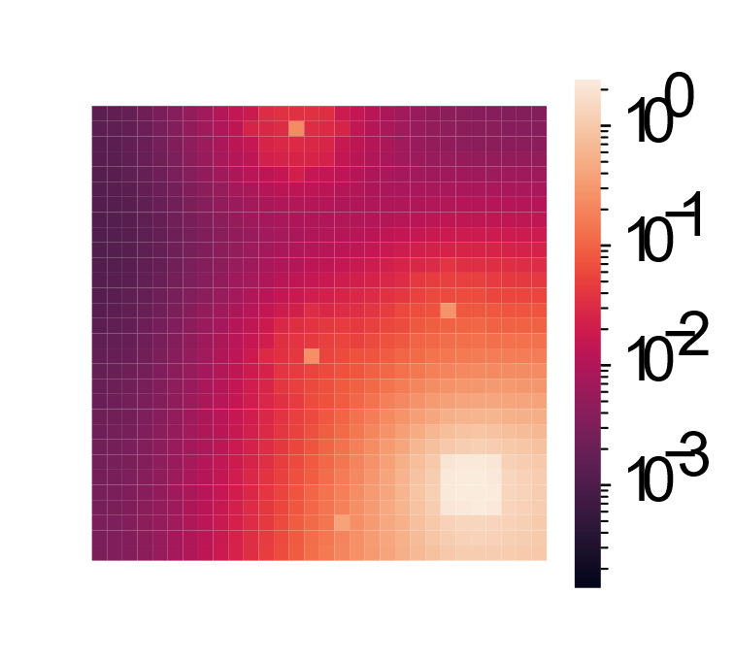
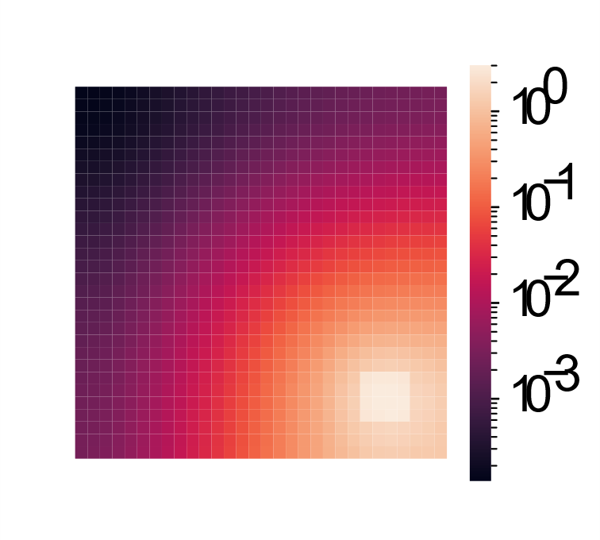
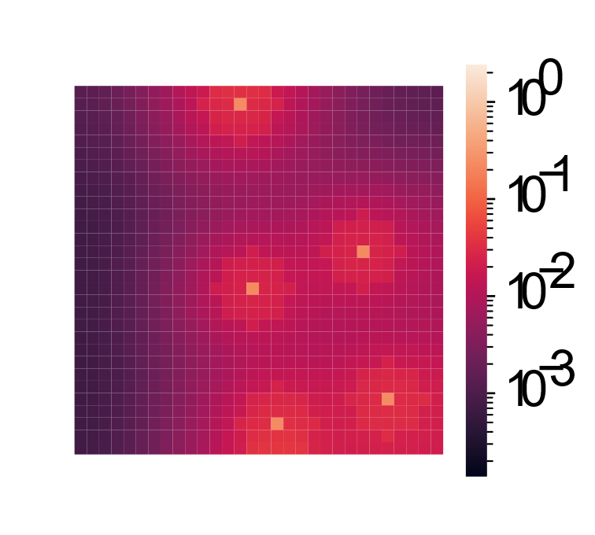
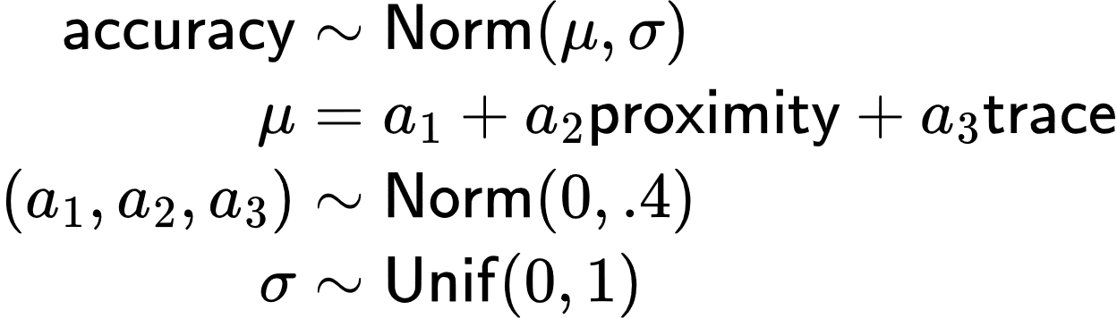
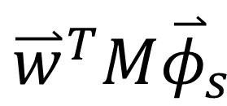
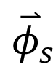
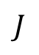
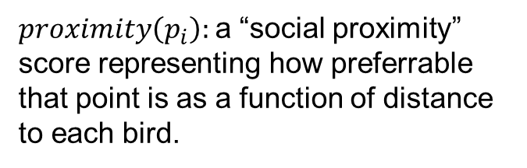
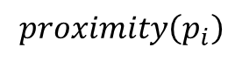
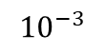
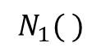
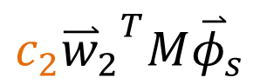
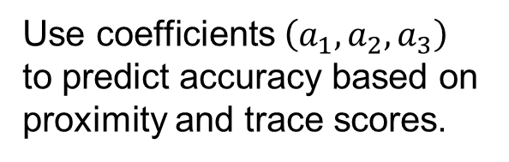
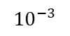
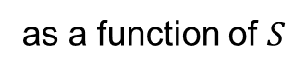
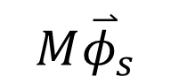
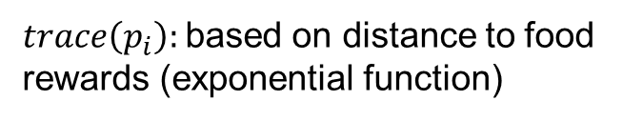
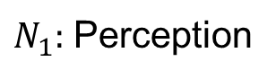
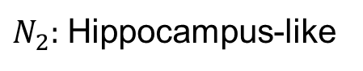
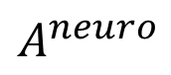
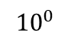
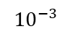
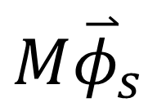
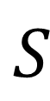
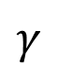
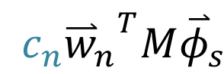
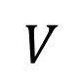
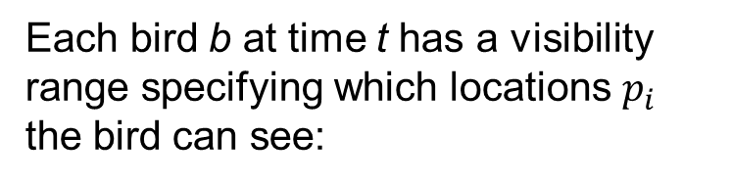
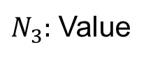
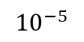

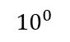






















Bridging cognitive, statistical, and neural descriptions of multi-agent bird foraging behavior
Marjorie Xie¹², Rafal Urbaniak¹³, Emily Mackevicius¹²
¹Basis Research Institute ²Columbia University ³University of Gdansk
Abstract
Cognitive, neural, and statistical descriptions
Statistical inference of foraging strategies
Toward inference of communication mechanisms in multi-agent bird flocks
Foraging in birds is a multi-agent social behavior that has been studied from several perspectives, including cognitive, statistical, and neural. We start from a specific type of cognitive description -- agents with an internal estimate of value that is expressed as a value function -- and translate this into a biologically plausible neural network implementation and into a statistical model where the statistical predictors correspond to components of the value function. We use the neural network implementation to simulate foraging agents in a variety of environmental conditions. In the multi-agent context, we investigate how the communication of information between different agents affects group foraging behavior. We find that communication was more beneficial in certain types of environments than others. To test the viability of the statistical approach, we simulate three different types of bird agents, and use Bayesian inference to recover what each type of agent values. Finally, we outline the main directions of future work, including new high-resolution video datasets we are collecting of multi-agent multi-species foraging behavior in the field.
Cognitive
Goal: Infer what the agents value from observations of movements and reward locations.
State
State
(perceived)
Predictive SR representation
Value
Action
We simulated two different foraging strategies:
Communicators share with other birds the locations of food rewards within their visibility range, and use this information to decide where to move.
$$S_{ }$$
$$N_{1}( )$$
$${\overset{⃑}{φ}}_{s}$$
$$N_{2}( )$$
$${M\overset{⃑}{φ}}_{s}$$
$$N_{3}( )$$
$${{\overset{⃑}{w}}^{T}M\overset{⃑}{φ}}_{s}$$
$$N_{4}( )$$
$$A^{cog}$$
Ignorers value only food.
as a function of $S$
Question: When does communication enhance foraging success?
$${10}^{0}$$
$${10}^{0}$$
We compared foraging performance in two different environments:
Distributed food
Communicators reach food rewards faster than ignorers.
Fewer communicators fail to find food than ignorers.
$${10}^{−5}$$
$${10}^{−3}$$
Strategy:
Simulate groups of birds, each with different foraging strategies: follower, hungry, and random-walking birds.
Fit a Bayesian model to each group to identify the extent to which different factors predict the locations of the birds.
$$M=Σ_{t=0}^{∞} {\left(γJ\right)}^{t}$$
$$J$$
State transition matrix
$$γ$$
Temporal discount factor
Neural
$$\overset{⃑}{w}$$
reward prediction vector
$N_{1}:$ Perception
$N_{2}:$ Hippocampus-like
$N_{3}:$ Value
$N_{4}:$ Motor output
$$proximity\left(p_{i}\right)$$
Each bird b at time t has a visibility range specifying which locations $p_{i}$ the bird can see:
Clustered food
Multi-agent foraging across species and communication within groups
$${{v=\overset{⃑}{w}}^{T}M\overset{⃑}{φ}}_{s}$$
$$A^{neuro}$$
Each point in space-time $p_{i}$ is assigned two scores:
$${\overset{⃑}{φ}}_{s}$$
$$\overset{⃑}{w}$$
$proximity\left(p_{i}\right):$a “social proximity” score representing how preferrable that point is as a function of distance to each bird.
Future directions
$$S_{ }$$
$${M\overset{⃑}{φ}}_{s}$$
From behavioral data, can we infer whether a group of birds is communicating?
To what extent do birds value information about food from other birds versus from their own experience?
Statistical
Under certain conditions, the most likely action is given by
$trace\left(p_{i}\right):$based on distance to food rewards (exponential function)
New datasets for multi-species bird foraging
$$A_{s}=argmax_{A} P\left(A | S\right)=A^{cog}=A^{neuro}$$
High resolution video data
Prediction task:
accuracy($p_{i}$): Euclidean distance between point $p_{i}$and bird’s chosen location $p⟨b, t+1 ⟩$.
Use coefficients $\left(a_{1},a_{2},a_{3}\right)$ to predict accuracy based on proximity and trace scores.
Outdoor multi-agent foraging
Thermal frame
RGB frame
Thermal max projection
Translation between descriptions
Foraging has been studied from cognitive, neural, and statistical perspectives.
Decomposition of value function across different sources of reward:
RGB
Thermal
$$V$$
$$=$$
$${{{c_{1}\overset{⃑}{w}}_{1}}^{T}M\overset{⃑}{φ}}_{s}$$
$$+$$
$${{{c_{2}\overset{⃑}{w}}_{2}}^{T}M\overset{⃑}{φ}}_{s}$$
$$+…+$$
$${{{c_{n}\overset{⃑}{w}}_{n}}^{T}M\overset{⃑}{φ}}_{s}$$
Bayesian model with prior distributions:
Identification
Tracking
Cognitive | Statistical | Neural
Goal: Describe the computations underlying behavior in terms of goals, beliefs, and vales | Goal: Fit empirical behavioral data | Goal: Uncover brain mechanisms behind behavior
Reinforcement learning (Dayan, Niv, Gershman, Stachenfeld, Momennejad, Deepmind, …) Optimal foraging theory (Krebs, Charnov, El Hady, Hill, …) | Minimal models (Levy Flights, Boids, and random walks, Bialek, Schneidman, …) Tracking video data (Sun, Kennedy, Pereira, Mathis, Perona….) | Drosophila (Jayaraman, Ruta, …), Nematodes (Bargmann, Calhoun,...), Hippocampus (Stachenfeld, Ulanovsky, Barack, Aronov, …)
“How much the bird values food”
“How much the bird values proximity to other birds
Spectrogram of vocalizations from foraging group (10s recording)
$${10}^{0}$$
$${10}^{0}$$
$${10}^{0}$$
$${(a}_{3})$$
$${10}^{−3}$$
$${10}^{−3}$$
$${10}^{−3}$$
Summary
Components as statistical predictors:
Inferred coefficient values represent the contribution of that factor in predicting the bird’s movements.
Framework unifying cognitive, neural, and statistical descriptions of foraging behavior
Inference of foraging strategies from simulated data
Role of communication in different environments
New datasets of multi-agent bird foraging
$$P\left(A | S\right) = h(a_{1}f_{1}\left(s\right) + a_{2}f_{2}\left(s\right) +…+ { a}_{n}f_{n}(s) )$$
“To what extent locations of food rewards predict the bird’s behavior”
“To what extent locations of other birds predict the bird’s behavior”
$${(a}_{2})$$
Notes:
1

Slide 2



Bridging cognitive, statistical, and neural descriptions of multi-agent bird foraging behavior
(First names of authors increase interaction potential)
School Logo here
Section 1 (sizes):
Posters boards are 48” tall and 96” wide, but we recommend you leave a little border since you may not be able to pin at the vertical edge. Since PowerPoint does not let one define such a large paper size, this template is designed to be printed at 200%, yielding a 46” x94” poster. You can scale it up or down a bit (e.g. 42” is a common paper size at FexEd). Note there is no direct international A0.. A1 equivalent. The poster size is approximately three A0 boards next to each other, i.e., each column in this example is about one A0 board.
Ideally you want to keep it very readable: this is not your paper, it is a poster. 32pt here (64 final printing) is good for most text:
Sub-bullets are 28 here (56 final)
Don’t use smaller than 24pt in this template (which is 48pt in final printing at 200%)
Insert plenty of graphics and any math you need
When inserting graphics or equations, keep the resolution high (remember this will be printed at 200%). If you can see blocking artifacts at 400% magnification in PowerPoint, consider finding better graphics. This is an example of BAD/LOW RES GRAPHICS
Leave enough margin for pushpin and remember many big plotters cannot get within .5” of the actual paper edge.
You are free to use colored backgrounds and such but they generally reduce readability.
You are free to use what ever fonts you like.
San Serif fonts like Arial are more readable from a distance,
Serif fonts like times may look more consistent with your mathematics
Section 2 (layout):
Remember the poster session will be crowded so design the poster to be read in columns so people can read what is in front of them and move left to right to get the whole story.
The poster should use photos, figures, and tables to tell the story of the study. For clarity, present the information in a sequence that is easy to follow.
There is often way too much text in a poster - there definitely is in this template! Posters primarily are visual presentations; the text should support the graphics. Look critically at the layout. Some poster 'experts' suggest that if there is about 20-25% text, 40-45% graphics and 30-40% empty space, you are doing well.
Section 3:
Include more figures than are in the paper so you can talk to them. Include things that are not in the paper and then encourage them to read the paper. Don’t try to just put all the paper here.
If it looks like a cut/paste of the paper, people skip that poster since they can read the papers after the conference. Many people find it better to spend time talking with poster presenters that have more to offer than just redoing the paper content paper in big fonts.
People will likely have already seen your posted video, so the poster can serve as a talking point for you.
Remember Poster boards look like this.. This is your canvas. Paint us a picture of your work.
Summary/Conclusion
Summarize your contributions
Summarize your results (if applicable)
You an add in links to additional videos, code, or project website (or QR code)
References
Notes:
2

Slide 3

We simulated two different foraging strategies
Communicators share with other birds the locations of food rewards they can see
Ignorers care only about food
Key results:
Communicators foraged more successfully than ignorers.
The benefits of communication are more pronounced in clustered food environments.
Implication: inference algorithms should be able to infer whether birds in a flock are communicating
Inference questions for future work:
To what extent do the birds value information about rewards from other birds versus from their own experience?
Latent cognitive variables (goals values, beliefs)
Behavioral and neural data
Statistical inference
We simulated two different foraging strategies
Communicators share with other birds the locations of food rewards they can see
Ignorers care only about food
Key results:
Communicators foraged more successfully than ignorers.
The benefits of communication are more pronounced in clustered food environments.
Implication: inference algorithms should be able to infer whether birds in a flock are communicating
Inference questions for future work:
Are the birds communicating?
To what extent do the birds value information about rewards from other birds versus from their own experience?
Limited observations
Latent cognitive variables (goals values, beliefs)
Behavioral and neural data
Statistical inference
Limited observations

Slide 4
TODO: go through intro, scrape references, add to list
Cognitive
Goal: Describe the computations underlying behavior in terms of goals, beliefs, and values
Statistical
Goal: Fit empirical behavioral data
See work on minimal models (Levy Flights, Boids, and random walks, Bialek, Schneidman, …), and tracking video data (Sun, Kennedy, Pereira, Mathis, Perona….)
Neural
Goal: Uncover brain mechanisms behind behavior
See work on Drosophila (Jayaraman, Ruta, …), Nematodes (Bargmann, Calhoun,...), and Hippocampus (Stachenfeld, Ulanovsky, Barack, Aronov, …)
See work on reinforcement learning (Dayan, Niv, Gershman, Stachenfeld, Momennejad, Deepmind, …), and optimal foraging theory (Krebs, Charnov, El Hady, Hill, …)
Cognitive | Statistical | Neural
Goal: Describe the computations underlying behavior in terms of goals, beliefs, and values | Goal: Fit empirical behavioral data | Goal: Uncover brain mechanisms behind behavior
reinforcement learning (Dayan, Niv, Gershman, Stachenfeld, Momennejad, Deepmind, …), and optimal foraging theory (Krebs, Charnov, El Hady, Hill, …) | minimal models (Levy Flights, Boids, and random walks, Bialek, Schneidman, …) tracking video data (Sun, Kennedy, Pereira, Mathis, Perona….) | Drosophila (Jayaraman, Ruta, …), Nematodes (Bargmann, Calhoun,...), and Hippocampus (Stachenfeld, Ulanovsky, Barack, Aronov, …)

